Slide 1
Hampton Manor Richmond, LLC REZ2022-00018 PUP2022-00014
9301 Patterson Avenue

Slide 2
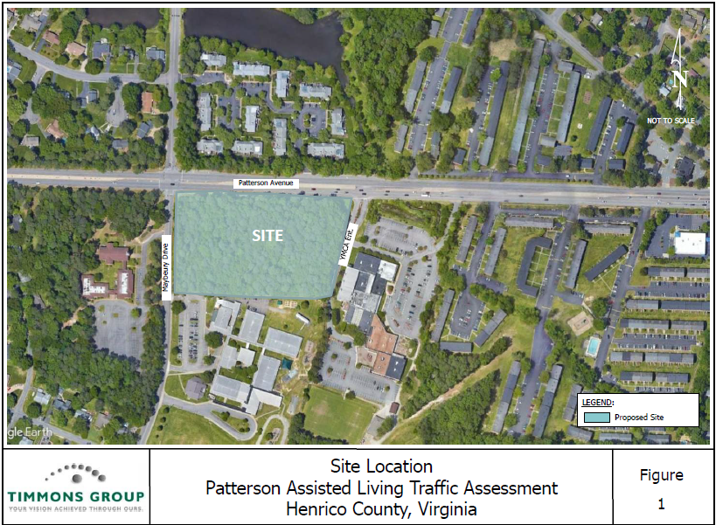

Slide 3
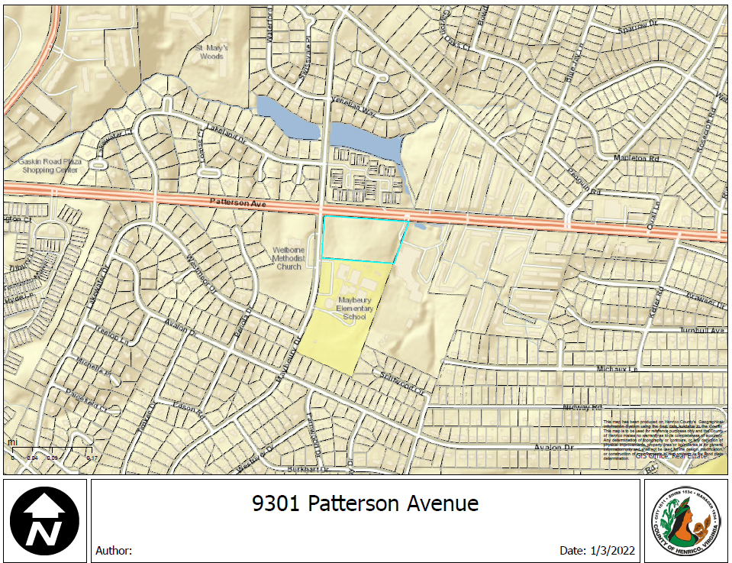

Slide 4
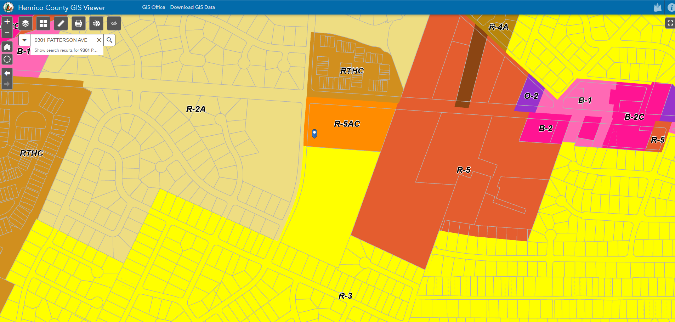

Slide 5
Project information
The property is currently zoned R-5AC which allows for 30 single family homes.
Proposed rezoning to R-6C (with a PUP) to allow for a one story assisted living facility with memory care (proposed not to exceed 98 units: 63 assisted living units and 35 memory care units).

Slide 6
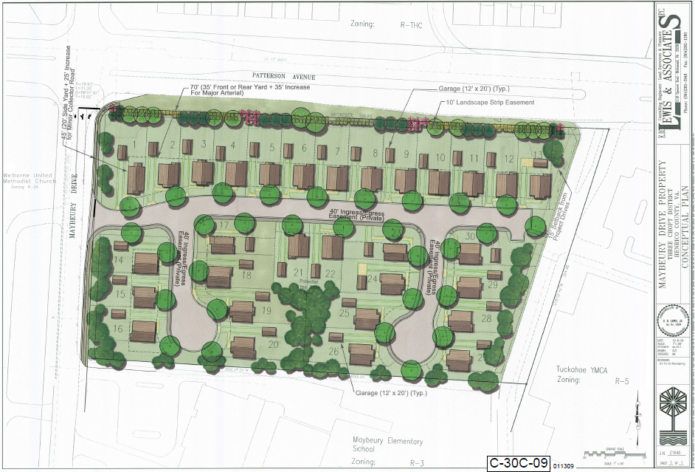
PRIOR CASE FROM 2010 – CURRENT ZONING

Slide 7
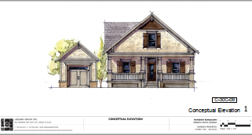
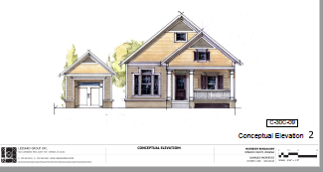
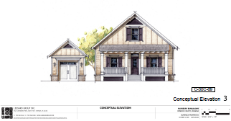
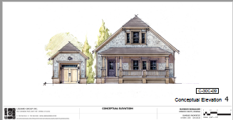
PRIOR CASE FROM 2010 – CURRENT ZONING

Slide 8
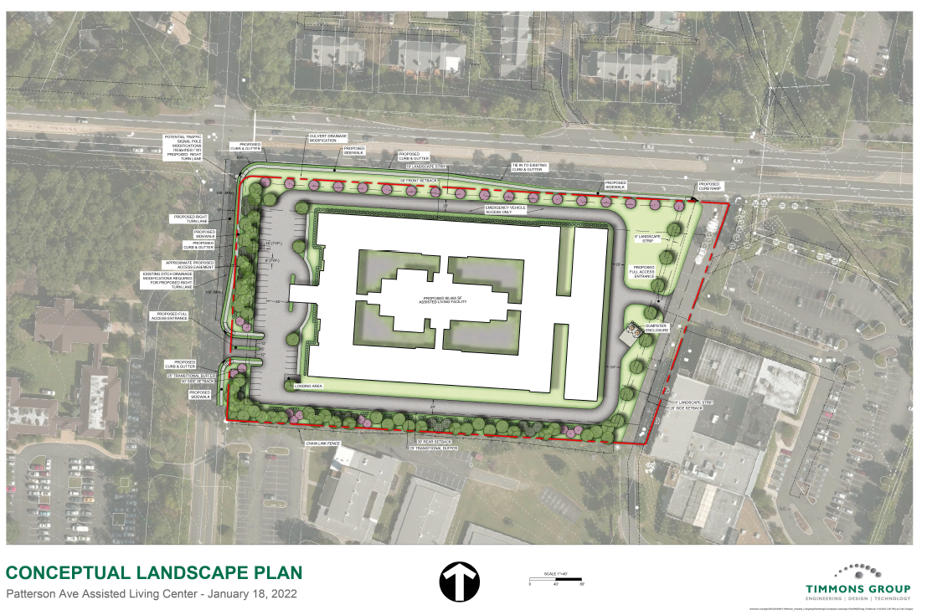

Slide 9
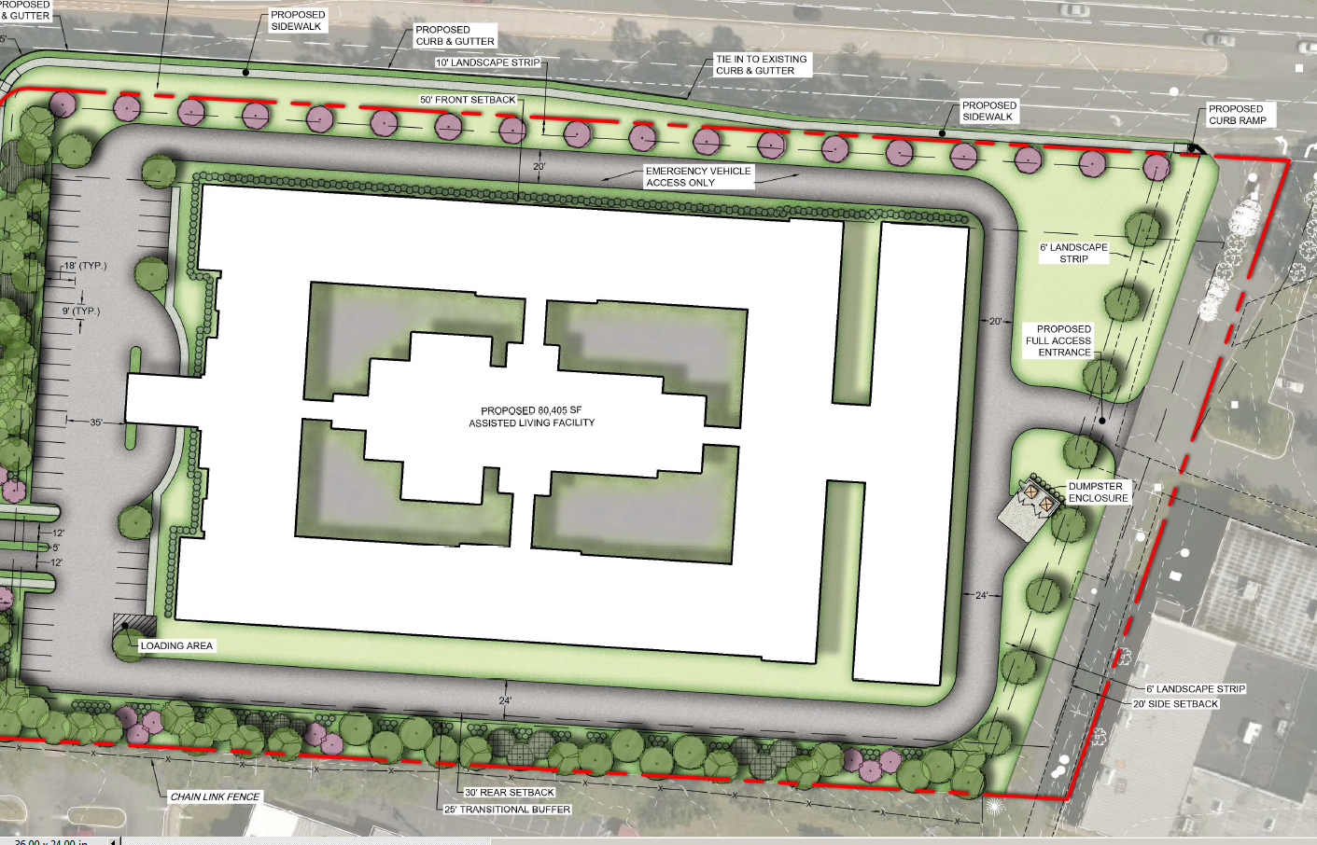

Slide 10
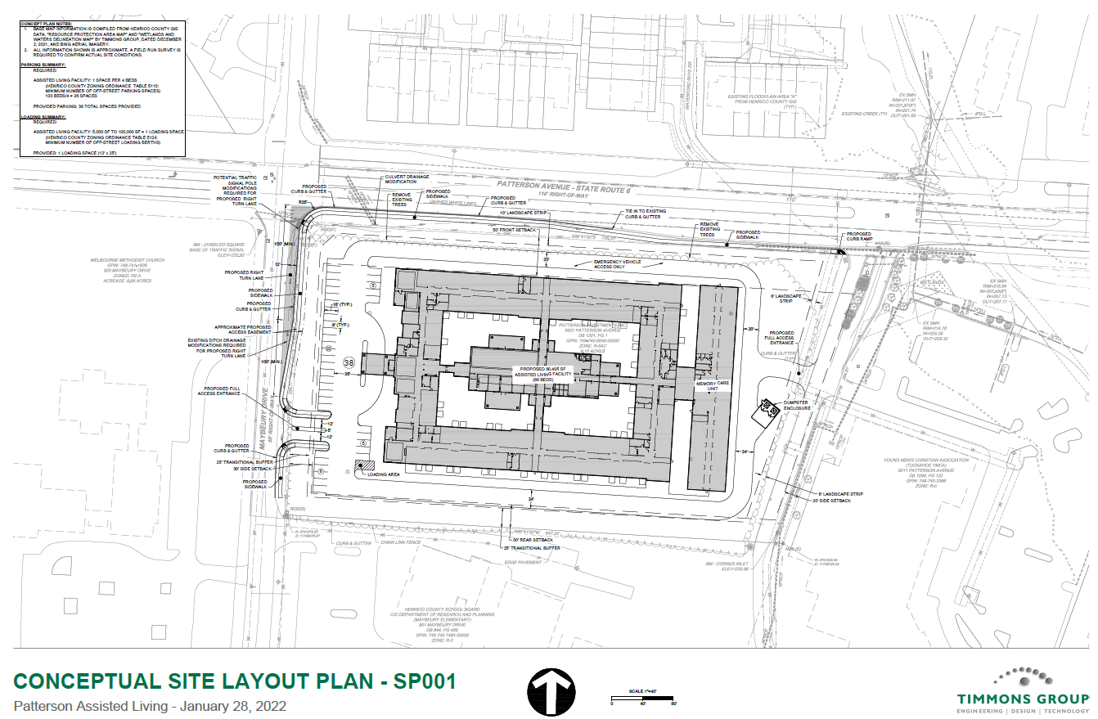

Slide 11
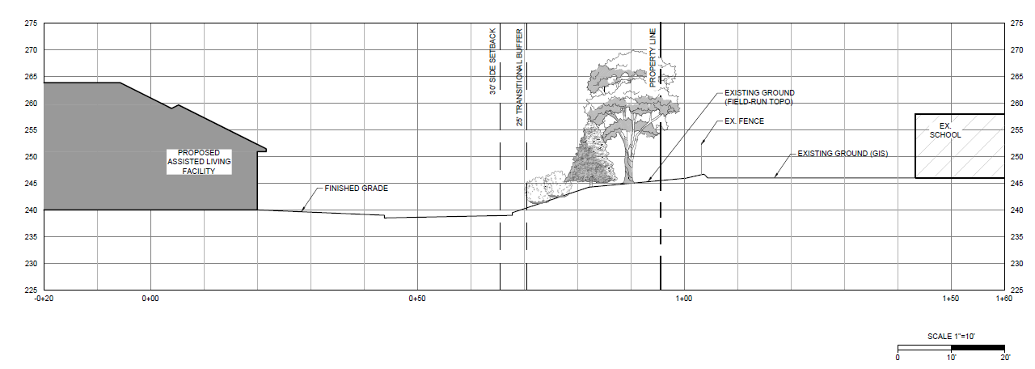

Slide 12
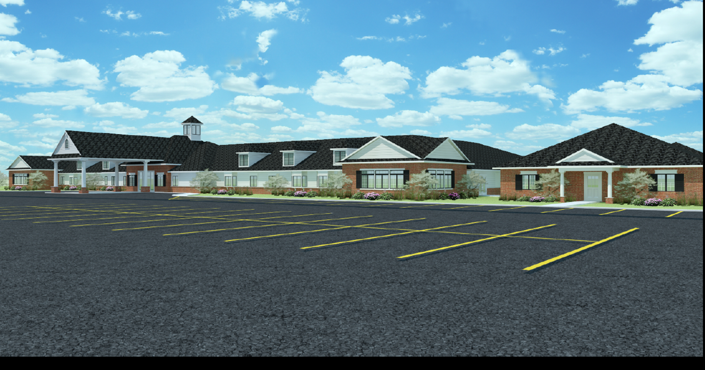
Existing Williamsburg Facility

Slide 14
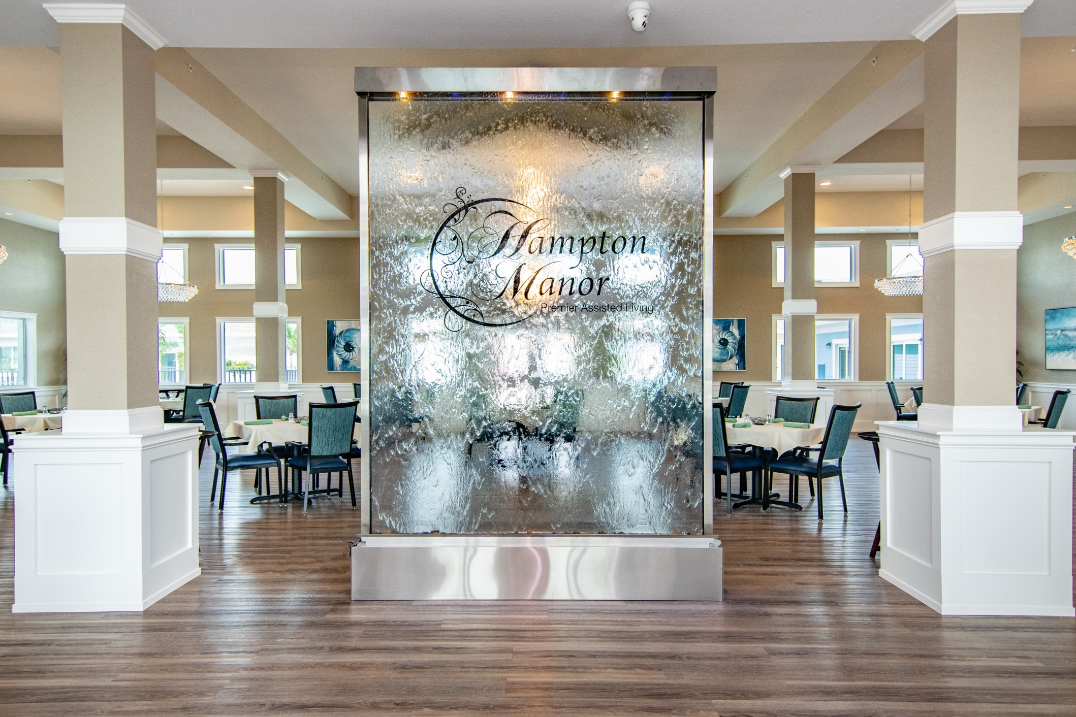

Slide 15
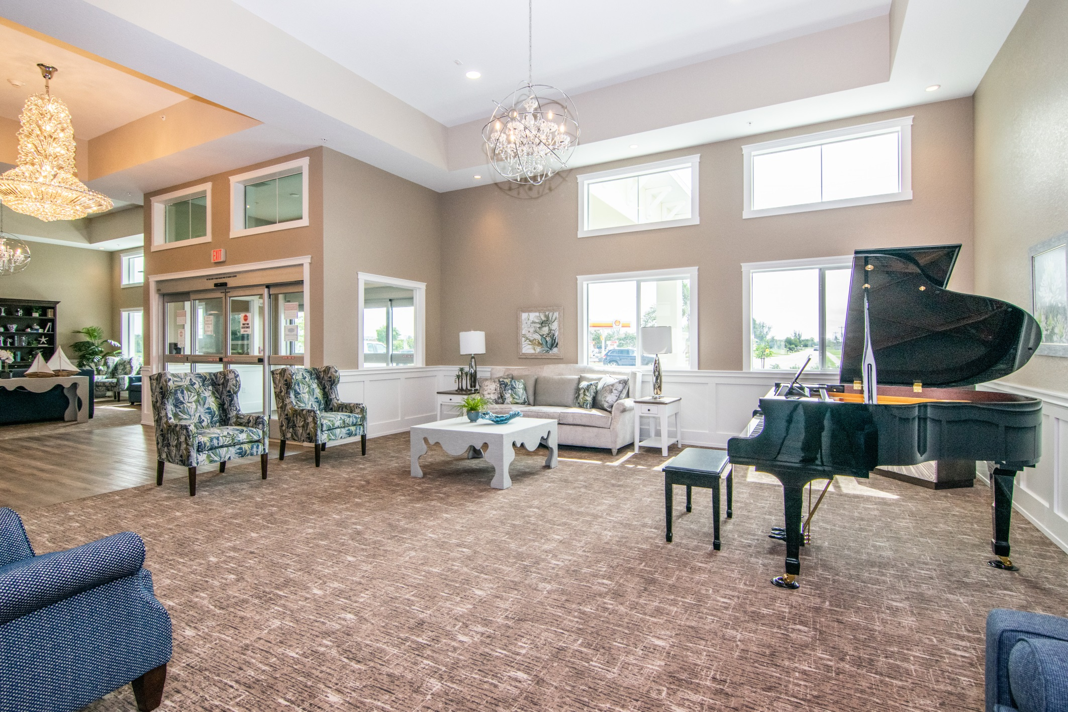

Slide 16
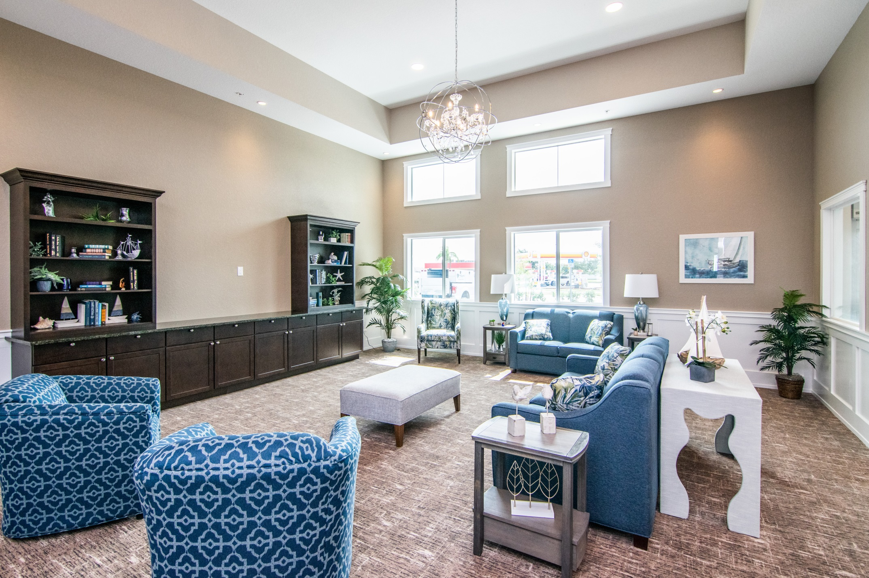

Slide 17
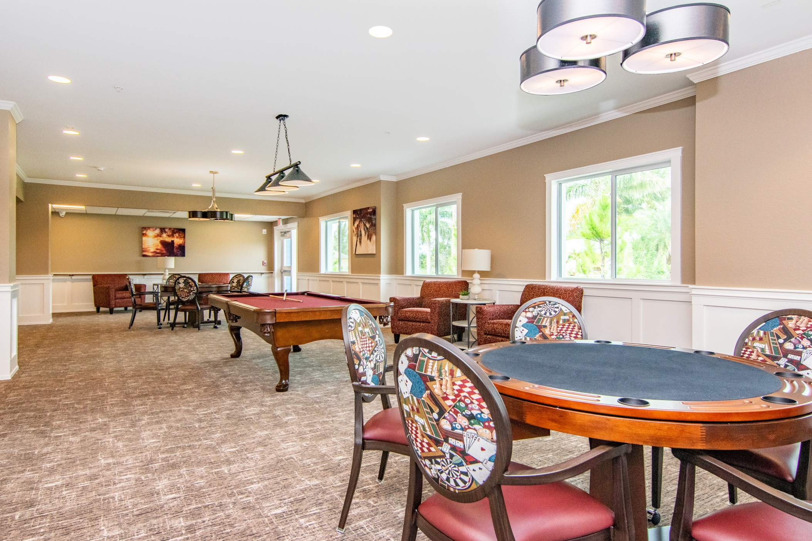

Slide 18
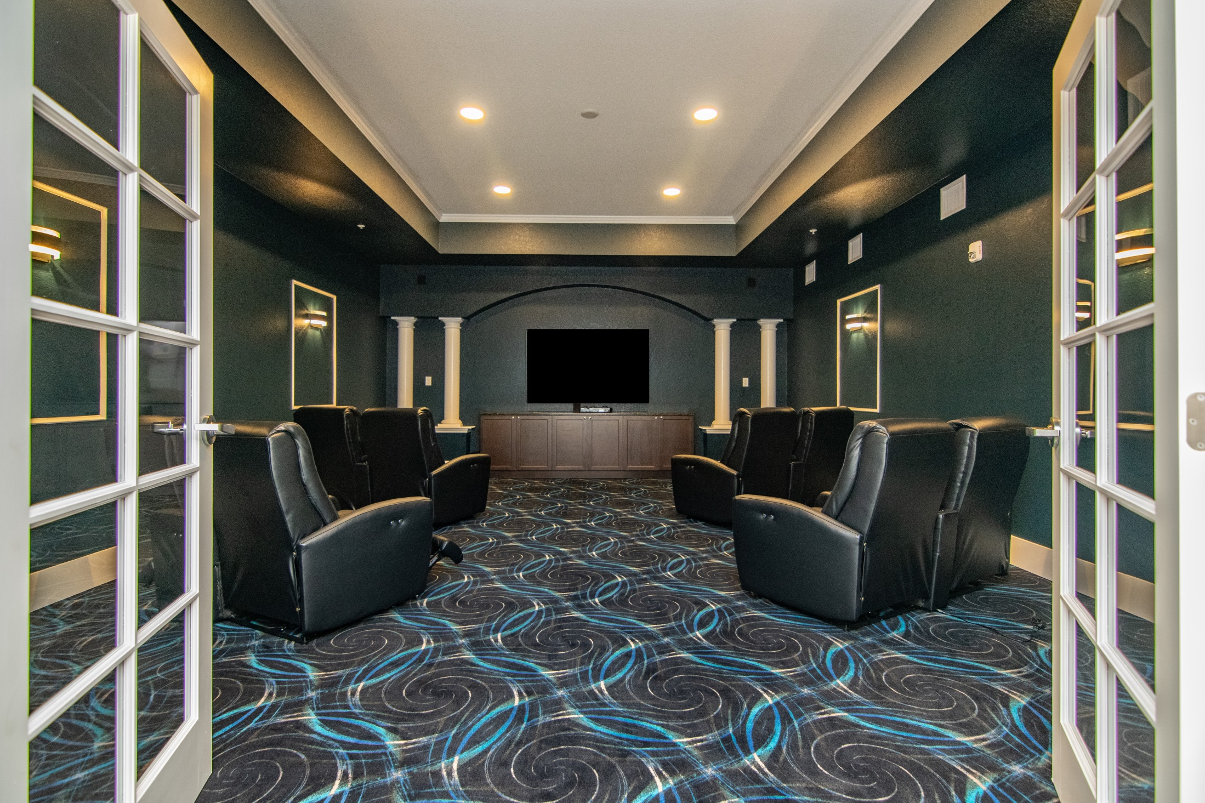

Slide 19
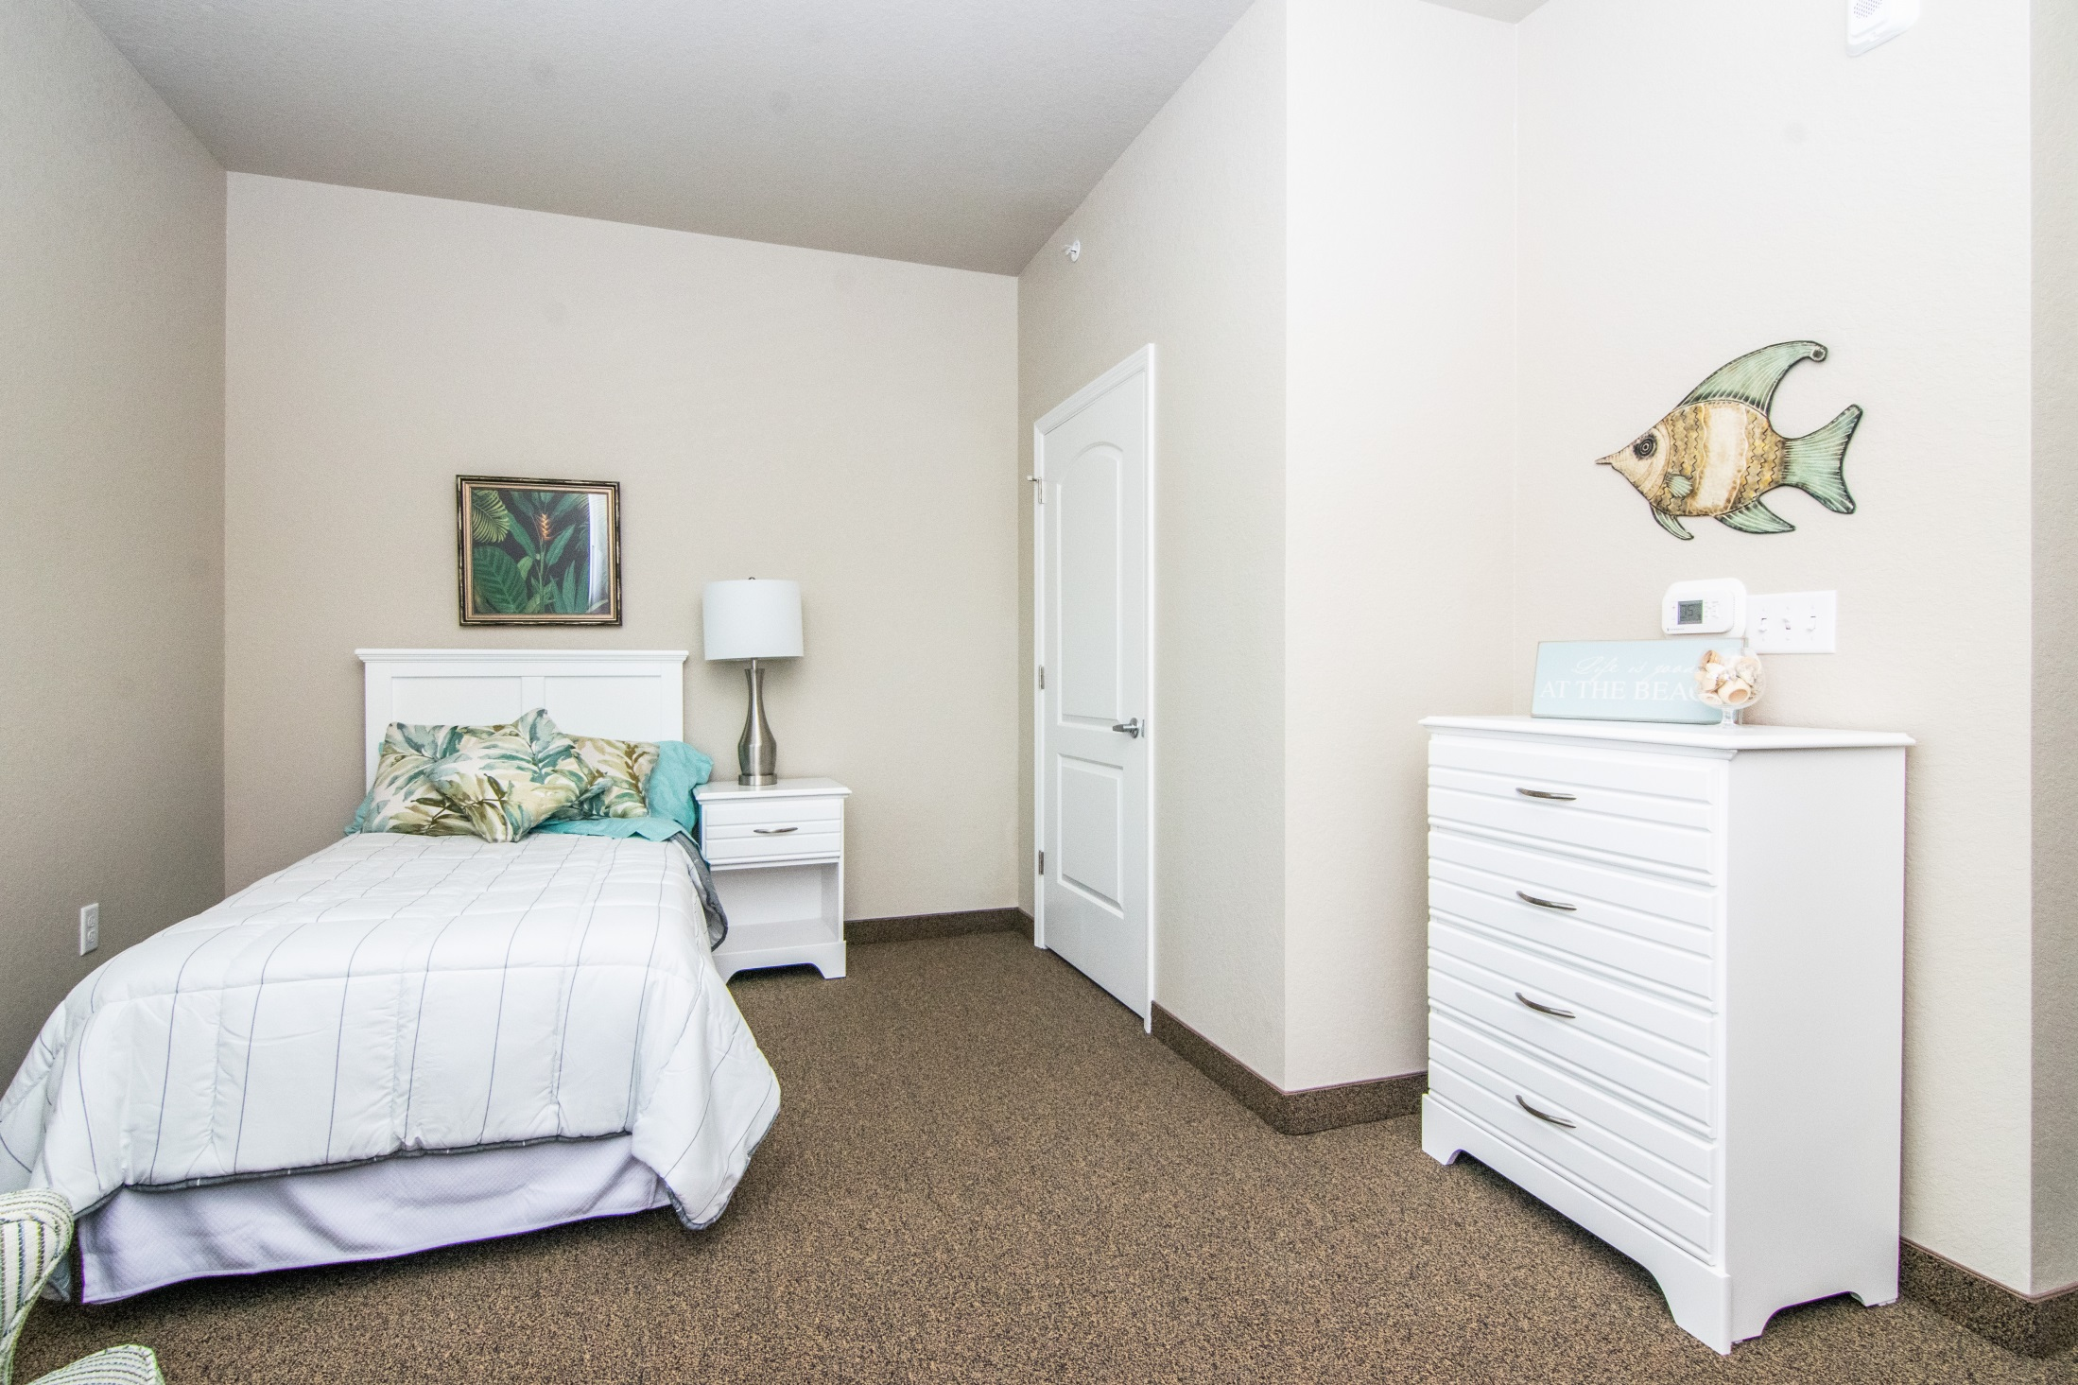

Slide 20
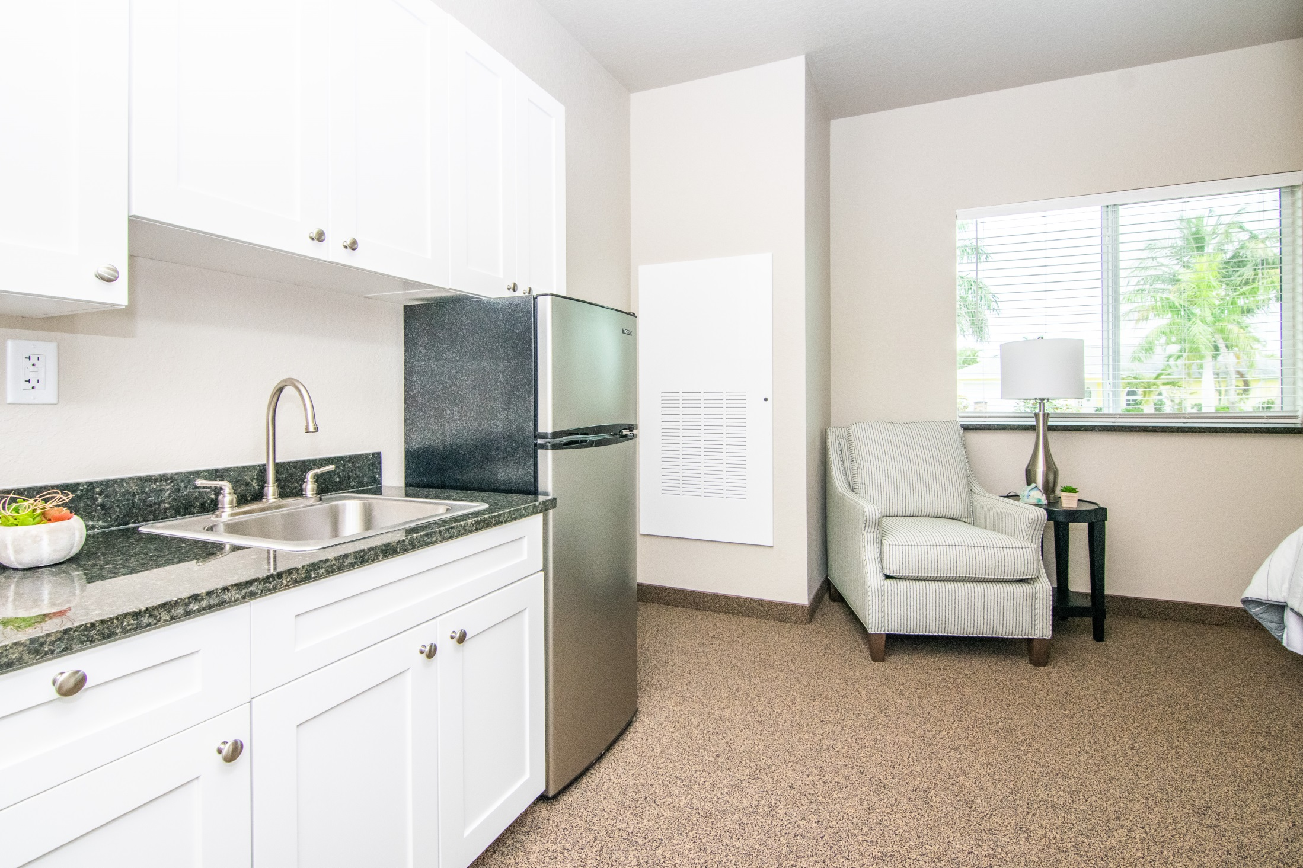

Slide 21
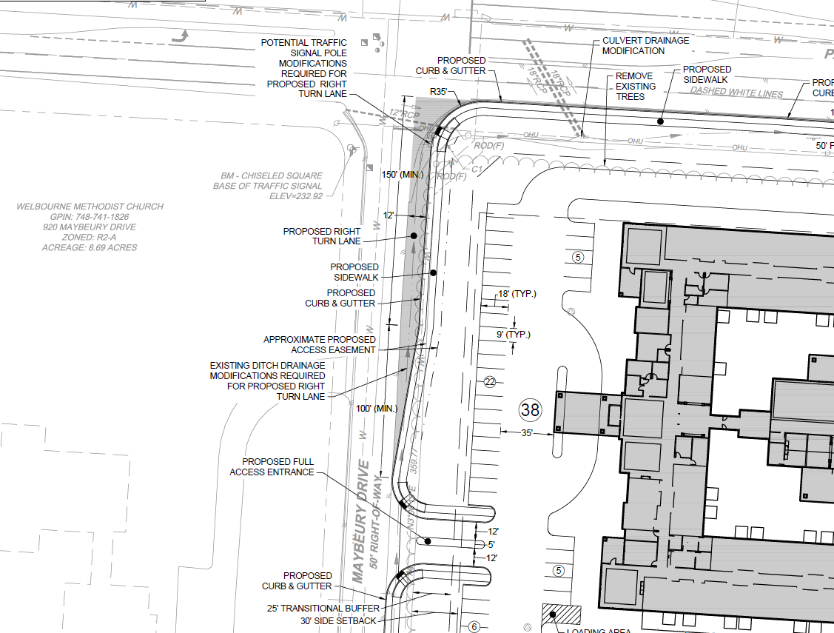

Slide 22
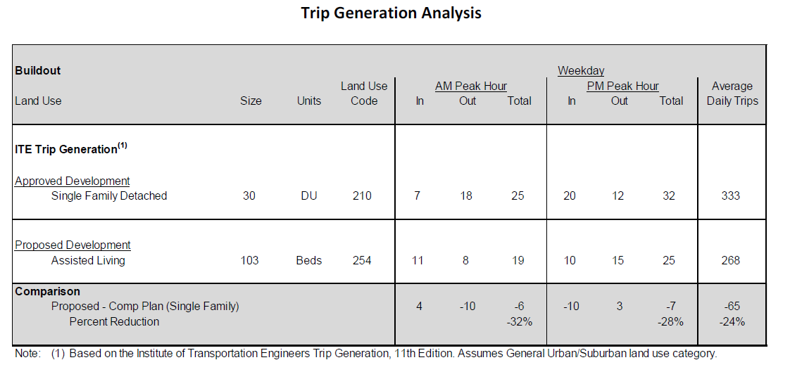

Slide 23
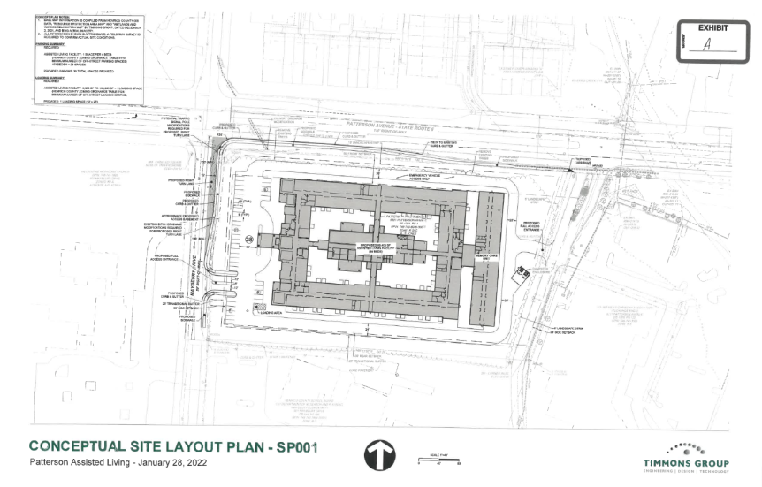
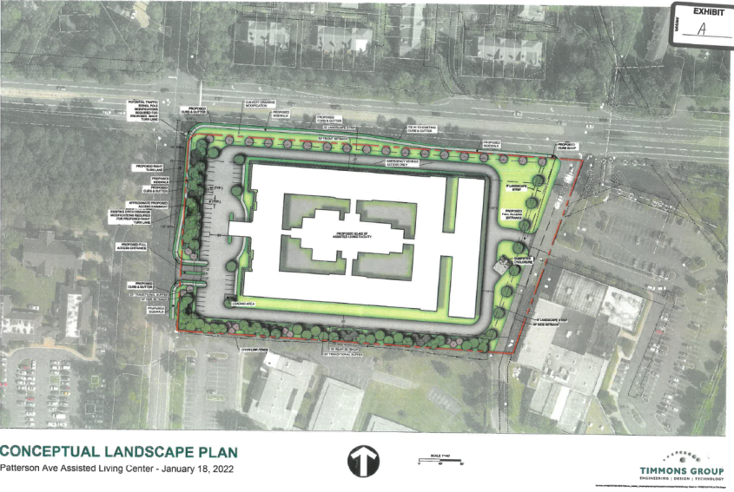
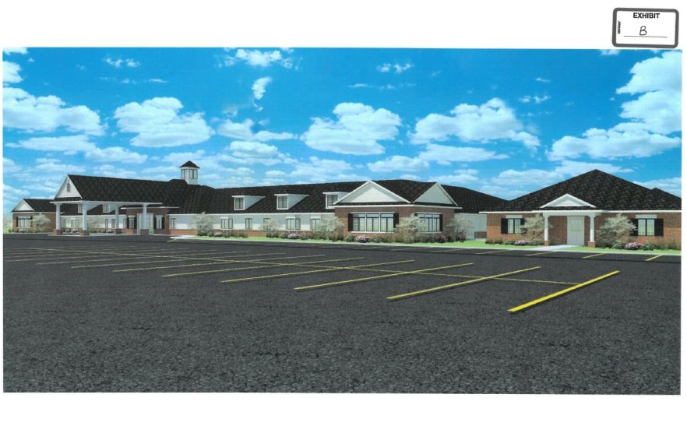
Application Made
On website – www.rvazoning.com
Includes following exhibits
Concept Plans
Landscaping Details
Elevations

Slide 24
Proffered Conditions
Only use permitted is an assisted living facility with no more than 103 units
Concept Plan
Elevations
All buildings to be constructed of brick, stone or cementitious siding
Specific buffer requirements
25’ on Maybeury Drive
25’ on Maybeury Elementary
With a 42” decorative rail fence
6’ on YMCA
10’ on Patterson Avenue
Stormwater facilities requirements
Maybeury Drive improvements, with entrance feature
Sidewalks on Patterson and Maybeury

Slide 25
Proffered Conditions (continued)
Development Standards
Parking lot lighting limited to 20’
with no more than ½ foot candle at property line
HVAC screening
Trash dumpster screening
Construction Standards
Hours – 7 am to 7 pm – Monday – Saturday
Construction traffic only through YMCA entrance
Mud wash shall be required
No burning of natural materials or construction debris
Temporary construction feet
6’ in height
Along Maybeury Elementary and Maybeury Drive

